Slide 1

Large Language Models (LLMs) Workshop
Introduction and Hands-On Examples

Slide 2
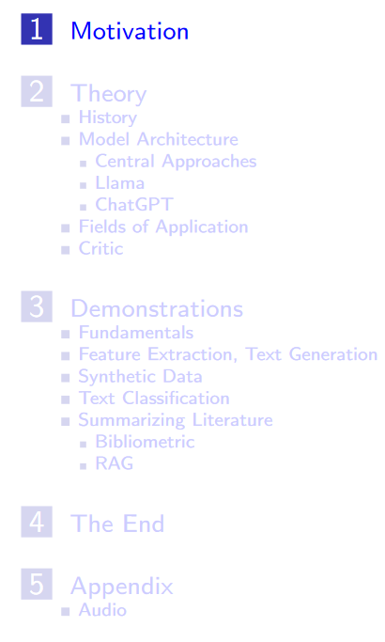
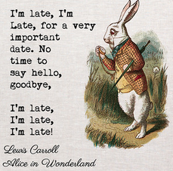
Workshop procedure Too much too little time > 200 slides
~ first 1 – 1,5 hours: theory
rest “3. Demonstrations”
Relatively little interaction, more in the form of a monologue

Slide 3

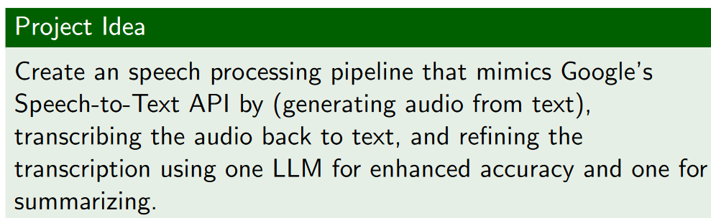
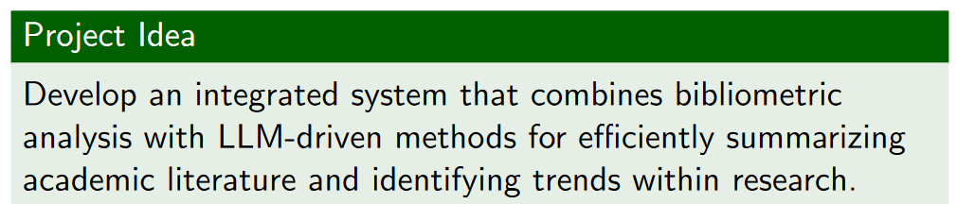
Workshop procedure Too much too little time > 200 slides
the slides can be used for reference and self-study
Two long-term ideas
Set up working groups regarding X if desired?
Conduct another “hands on” workshop?

Slide 4

Record my screen
Open Broadcaster Software (OBS) Overview:
OBS Studio is a free, open-source software used for video recording and live streaming.
Screen Recording:
I will only record the screen from my shared window and record my audio.
Intended Use:
For Internal Use Only: Screen recordings created with OBS are solely for internal documentation.
Goal:
A student will apply LLMs locally to
transcribe the audio file to text
to summarize the text
To write a documentation for students in the future about LLMs, something like https://www.uni-mannheim.de/media/Einrichtungen/Koordinationsstelle_Studieninformationen/Dokumente/Erstsemester/ChatGPT_Handreichung_Studierende_UMA_Stand_Mai_2023.pdf
Does anybody NOT want my split screen to be recorded?

Slide 5


Who am I?
EDUCATIONAL TRAINING
Sep 2015 – Sep 2018 Applied Statistics (M.Sc.), University of Göttingen
Sep 2012 – July 2015 Psychology (B.Sc.), Université de Fribourg (CH)
PROFESSIONAL TRAINING
Since April 2024 PostDoc Project in the DFG Research Training Group “Statistical Modeling in Psychology”, primary advisor Prof. Kiesel (University of Freiburg)
October 2020 – March 2024 PhD Project in the DFG Research Training Group “Statistical Modeling in Psychology”, primary advisor Prof. Kiesel (University of Freiburg)
Since Jan 2020 freelancer: coach for data analysis (supervision of bachelor, master and doctoral theses), private tuition on statistics

Slide 6
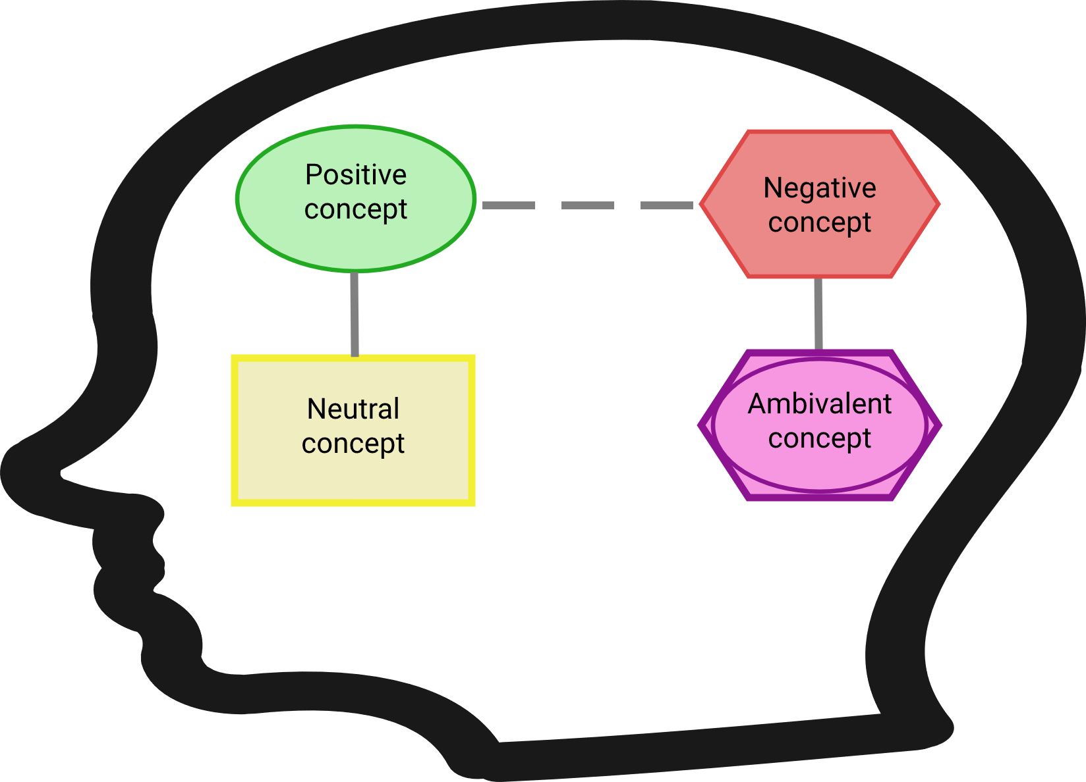
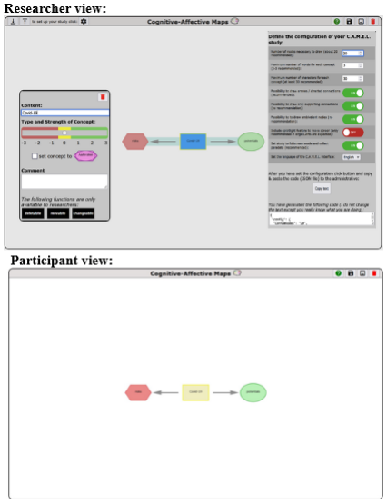
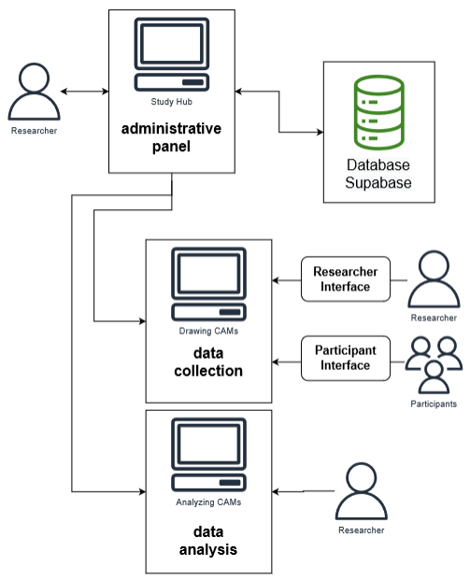
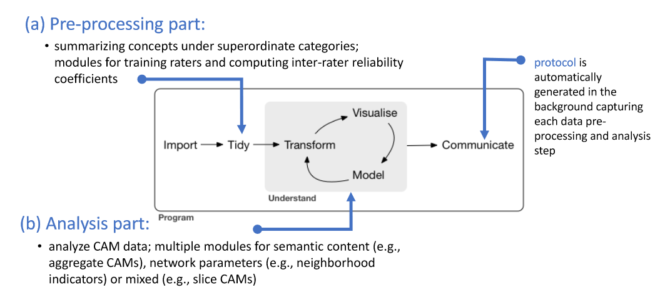
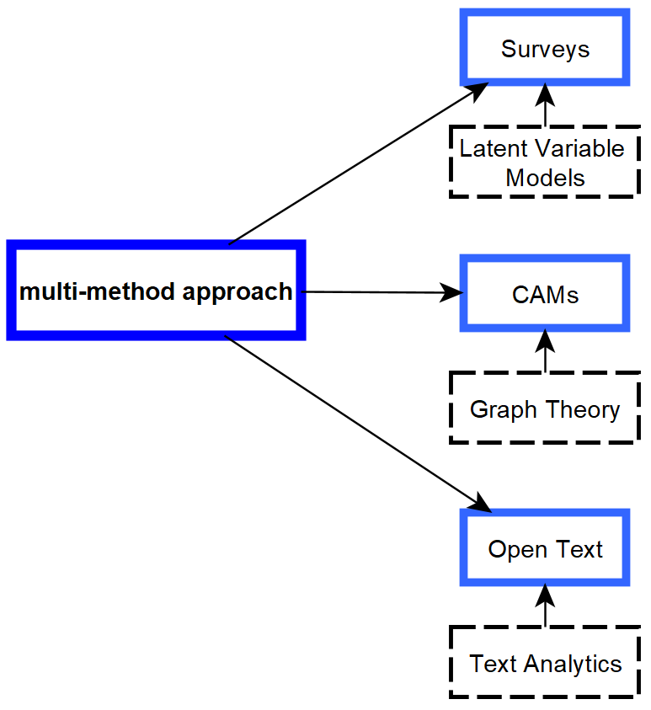
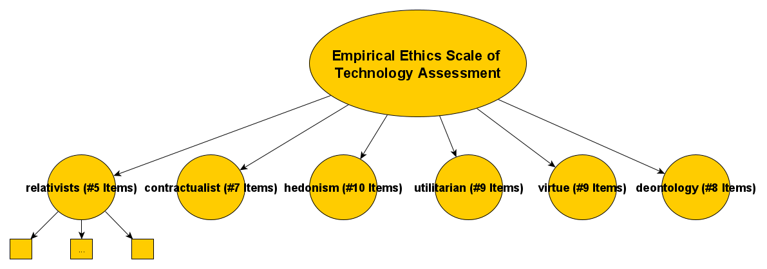
My research <-> LLMs
Semantic Networks: Cognitive-Affective Maps extended logic: Proposing Tools to Collect and Analyze Attitudes and Belief Systems
Empirical Ethics: Development and Validation of an Empirical Ethics Scale for Technology Assessment - Challenges and Perspectives for a Real Time Ethics for Emerging Technologies
Prospective Technology Assessment: Propose methodologies to investigate (ethical) concerns of technologies at an early development stage.

Slide 7
Current project <-> LLMs
Evaluate the psychometric properties of the benchmark
MMLU (Massive Multitask Language Understanding
Analyze over 12.000 items by Latent Variable Models (IRT)
Together with:
Dr. Aron Fink (https://www.psychologie.uni-frankfurt.de/73548927/Dr__Aron_Fink)
Tom Sühr (https://tomsuehr.com/)

Slide 8
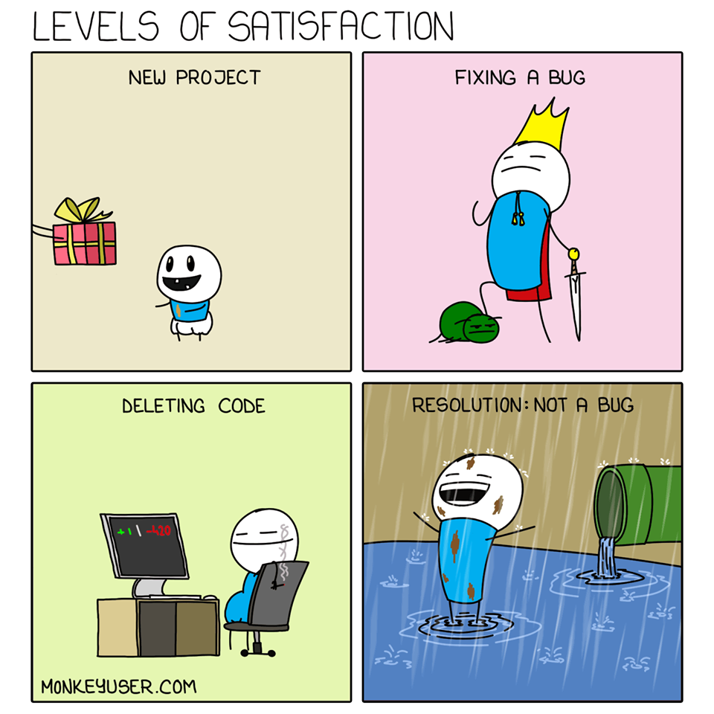

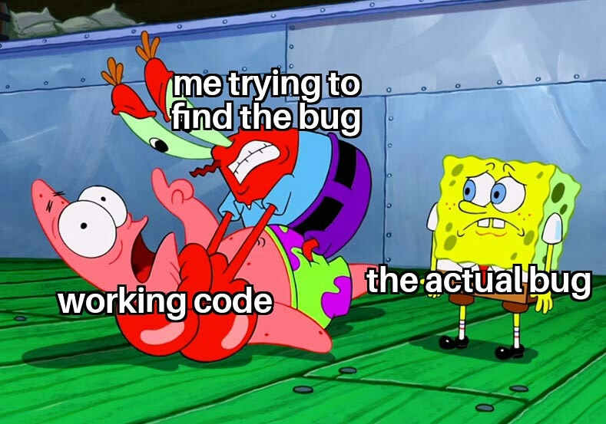
Let’s start
How I felt while preparing the workshop:
Stunned in disbelief
How to set up my computer?!?!?!?!?

